Slide 1
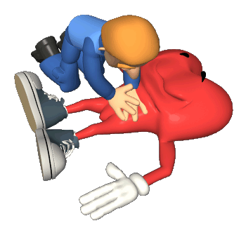




TYPE II NON-HEART BEATING DONORS: HOW MANY POTENTIAL DONORS ARE WE MISSING?

Slide 2

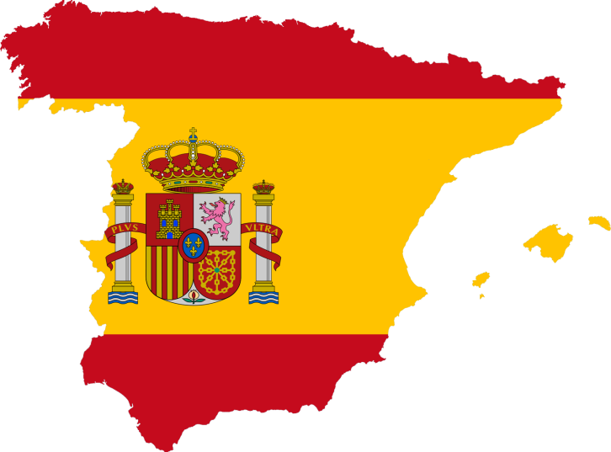
Oshcar Objective
Out of hospital cardiac arrest registry
Database of 1 year of all CPR in Spain

Slide 3
Methods
Based on the Spanish Out-of-Hospital Cardiac Arrest Registry (OHSCAR)
A prospective nationwide registry.
Nineteen public emergency services (EMS), all of them with physician on board, cover a population of 46,343.659 inhabitants.
Inclusion criteria in OHSCAR: patients suffering an OHCA attended by an emergency team (ET) from any of the Spanish EMS.

Slide 4
Items
patient age,
estimated time of OHCA,
whether cardiopulmonary resuscitation (CPR) maneuvers were or were not initiated,
time of CPR onset and outcome of CPR.
…

Slide 5
Objective
To estimate the number of potential donors type II Maastricht who were not included in donation programs, after an out-of-hospital cardiac arrest attended by EMS

Slide 6
Methods
Period: 1st October 2013 – 31st October 2014 (13 months)
Inclusion criteria*:
Absence of Return of Spontaneous Circulation (ROSC)
Time interval from collapse to the onset of CPR maneuvers by emergency team < 15 minutes
Age from 16 to 60 years old (both included)
*Spanish National Transplant Organization (http://www.ont.es/infesp/DocumentosDeConsenso)

Slide 7
11918 patients
9549 cpr
3341
18-60 years old
2360 non cpr
2071
No ROSC
580
Time to scene<15 min

Slide 8
If we consider inclusion criteria of DCD …
  580 potential donors could have been included in type II Non-heart-beating donations programs
  48 donors per month
This figure represents the 6% of dead patients after an unsuccessful resuscitation

Slide 9
Limitations
There are exclusion criteria regarding comorbidities of
potential donors that are no possible to evaluate in our
estimation

Slide 10
Conclusions
There is an important room to improve donation programs increasing the Maastricht Type II donors.
EMSs must implement such programs

Slide 11
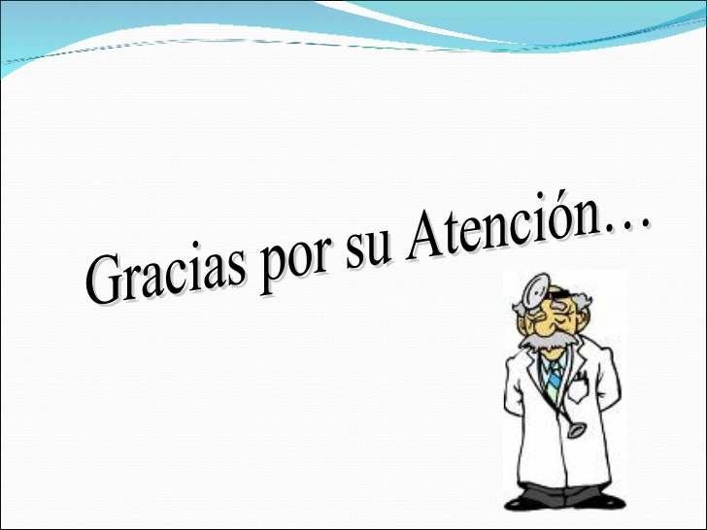



Thanks for your Attention…

